Slide 1

Cyber Security
Lecture # 04

Slide 2
Lecture Overview
Network Basics
Data Transmission
Internet
Basic Network Utilities
The OSI Model

Slide 3
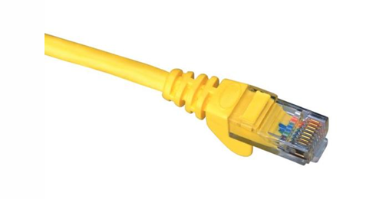
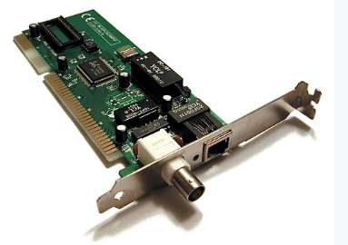
Network basics
A network is two or more connected computers.
A connection usually requires Network Interface Card (NIC) in both wire (cable) or wireless connection.
Traditional NIC uses a RJ 45 connector.
Uses a RJ 45 connector.
Allows the host to connect to the network.

Slide 4
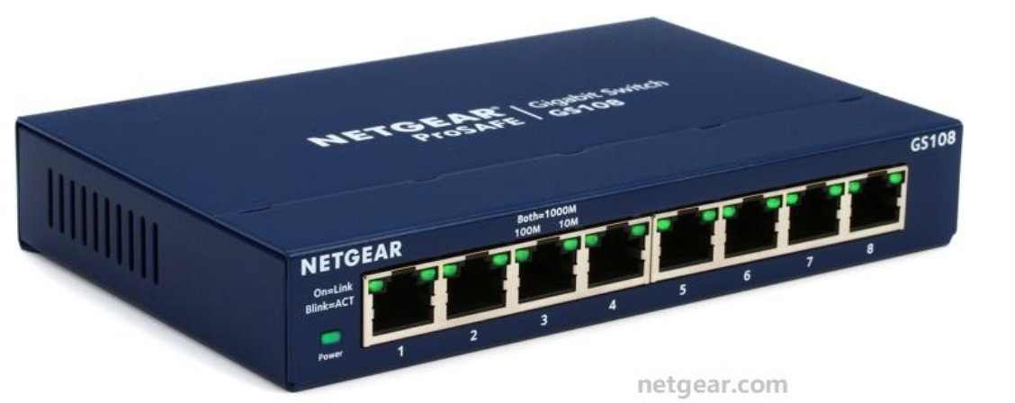
Network basics
The HUB is the simplest connection device, creates a simple network.
It will have 4 or more (commonly up to 24) RJ-45 jacks called ports.
A hub can connect as many computers as it has ports.
Sends traffic out all ports (no routing or switching) and has a layer 1 device
Quick Question?
If I need to connect more than 100 computers, how can I do that?
Using devices like a Hub, Switch, or Router with RJ45 cables!

Slide 5
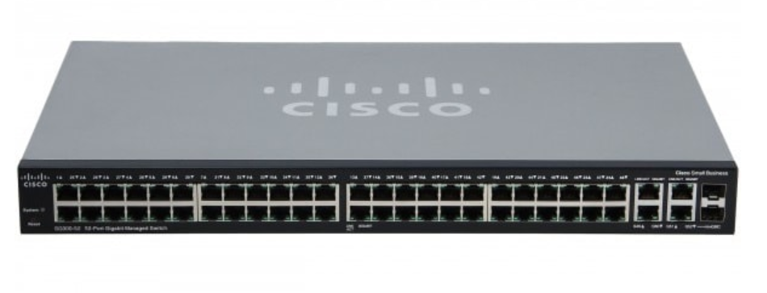
Network basics
The SWITCH is a smarter version of hub.
Sends packets only to the intended host.
It rely on MAC (Media Access Control) address, found in the ethernet header of the packet.
A layer 2 device

Slide 6
Network basics
Every device connected to the switch has a unique MAC address.
The switch keeps a MAC address table (like a contact list), it learns which MAC address belongs to which port.
How It Works:
When a packet arrives, the switch checks the destination MAC address in the Ethernet header.
Then it forwards that packet only to the port linked to that MAC address.

Slide 7
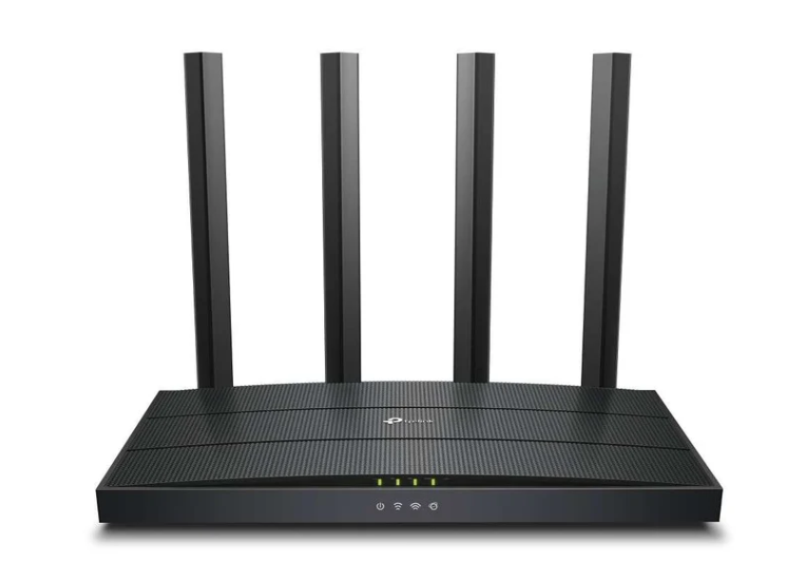
Network basics
The ROUTER is more sophisticated.
It connects different networks (like your home network to the internet).
It decides where to send data using IP addresses.
A layer 3 device
Quick Question?
Difference btw Hub, Switch and Router?

Slide 8
Data transmission
How is data actually transmitted?
To transmit data , a packet is sent.
The basic purpose is to transmit data from one machine to another.
It does not matter, the packet is a document, image, audio, video or any signal from the computer.
It always stored as 1s and 0s, called bits.
Packet is divided into header and body.

Slide 9
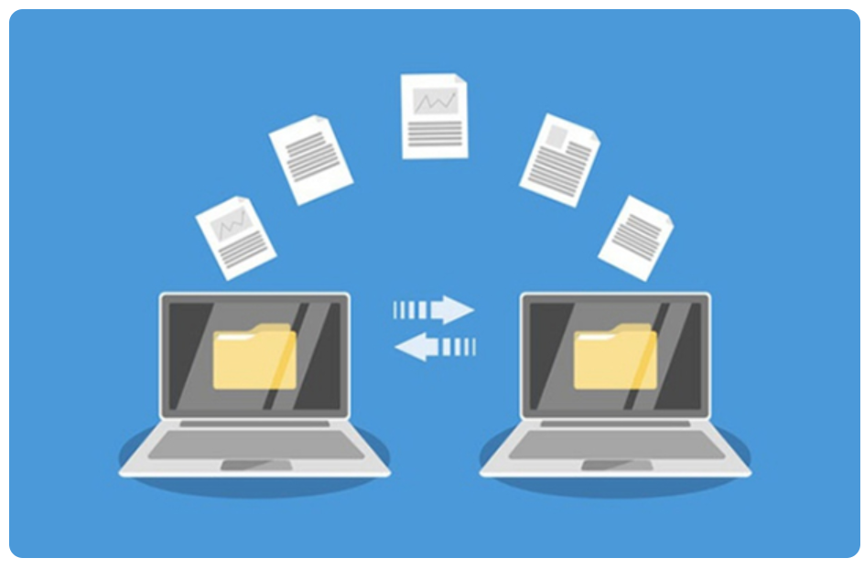
Packet headers tell where the packet is going.
Network devices (Switches/Routers) read the headers to determine where the packet should be sent.

Slide 10
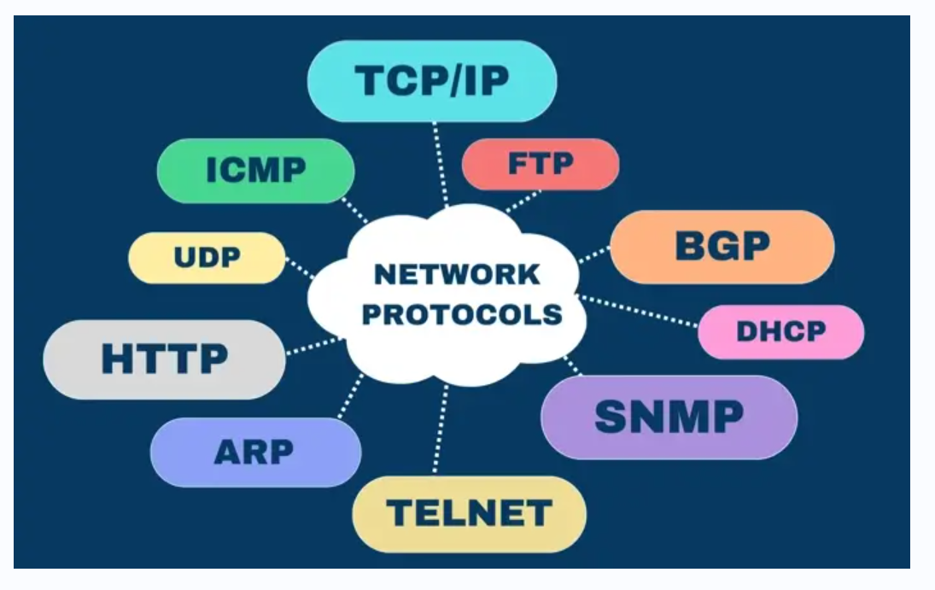
PROTOCOLS
Different types of network communications for different purposes are called Protocols.
Rules that control network and Internet communication.
Each Protocol has specific purpose and normally operates on certain Port.
Internet Engineering Task Force
(IETF) controls these rules.
Quick Read!
Transmission Control Protocol (TCP) is connection-oriented.
Internet Protocol (IP) is connectionless.

Slide 11
TCP/IP PROTOCOLS
The TCP/IP protocols are the foundation of how data is transferred and communicated over the internet.
FTP (File Transfer Protocol) is used to transfer files between computers.
FTPS (File Transfer Protocol Secure) is a more secure version that uses encryption to protect data.
SMTP (Simple Mail Transfer Protocol) handles the sending of emails.
IMAP (Internet Message Access Protocol) is used to receive and manage emails on a mail server

Slide 12
DNS (Domain Name System) translates domain names like google.com into IP addresses that computers understand.
HTTP (Hypertext Transfer Protocol) is used to transfer web pages, and its secure version.
HTTPS (Hypertext Transfer Protocol Secure), encrypts data for safe browsing.
TCP (Transmission Control Protocol) ensures reliable and ordered data delivery
UDP (User Datagram Protocol) focuses on speed and efficiency without guaranteeing delivery. Together, these protocols make network communication and internet usage possible.

Slide 13
PORTS
A connection point.
It is a numeric designation for a particular path of communications.
65535 network communications ports on computer regardless of type of computer and OS.
Not physical ports on a computer.
IP Address + Port number is referred to as a Socket.
Used by protocols to communicate

Slide 14
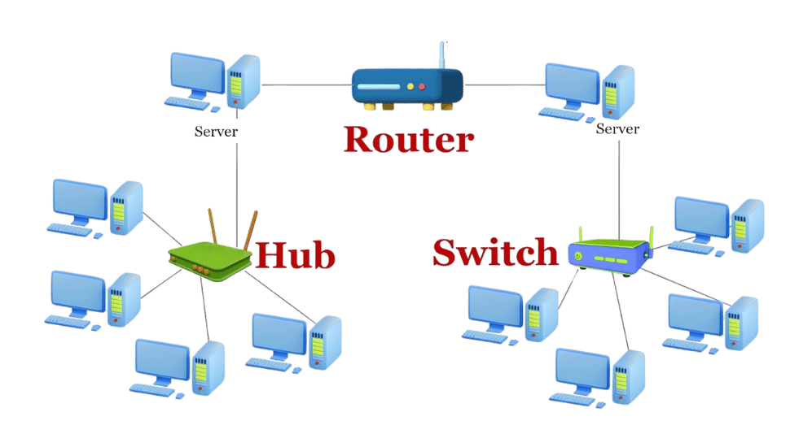
Simply, One machine connected to each other via cables, and perhaps to hubs, switches, or routers. These networks transmit binary information in packets using certain protocols and ports.

Slide 15
INTERNET
A large number of networks that are connected to each other.
These various networks are simply connected to main transmission lines called backbones.
The points where the backbones connect to each other are called network access points (NAPs).
To connect the internet, log on to an Internet service provider (ISP).
That ISP connects either to another ISP or backbone provider.
One backbone provider connects to another at a Network Access Point (NAP).

Slide 16
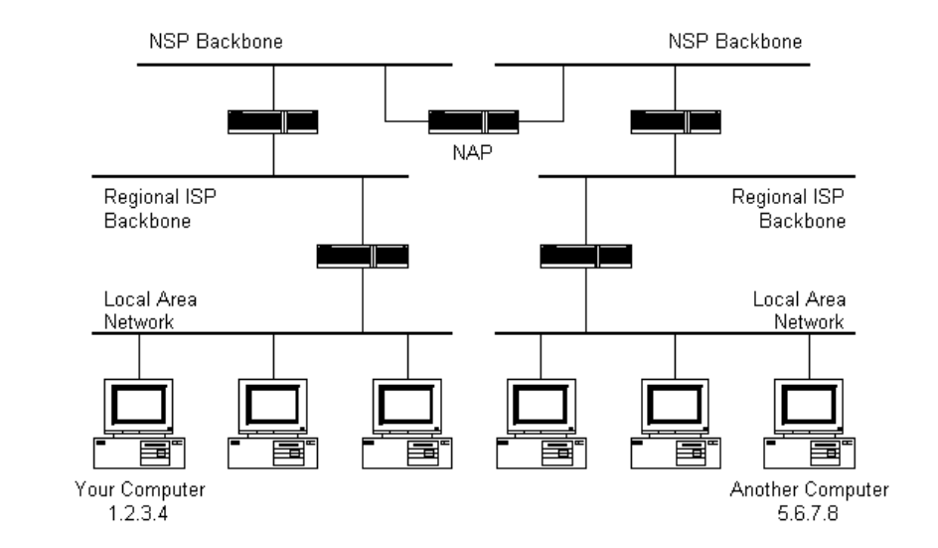

Slide 17
IP ADDRESS
IP (Internet Protocol) Addresses
Necessary to navigate the Internet
It is a unique identifier, like a Social Security number
Usually in binary form.
Consists of four octets separated by decimals.
(An example would be 107.22.98.198.) Each of the three-digit numbers must be between 0 and 255.

Slide 18
PUBLIC VS PRIVATE ADDRESS
Public addresses are routable on the Internet.
Must be leased from an ISP.
No two public IP can be the same.
Private IP uses numeric code that is not unique and can be used again
Public IP is used to get internet service.
Public IP often begins with 39.102.230.17.
Private addresses are not routable on the Internet.
Must be leased from an ISP.
Private IP uses numeric code that is not unique and can be used again.
Private IP works only on LAN.
Private IP often begins with 10.102.230.17

Slide 19
4.2 billion possible IP addresses
IPv4
Availability of IP addresses are not infinite.
An IP address is a series of four values, separated by periods.
These addresses are actually four binary numbers;
192.168.1.10
Each octet is a group of 8 bits (1 byte).
4 octets × 8 bits = 32 bits total.
Each octet can range from 0 to 255 (because 8 bits can represent 256 values).
An IPv4 address = 4 numbers (octets), each 0–255, separated by dots.
Example breakdown:
192 → 11000000
168 → 10101000
1 → 00000001
10 → 00001010

Slide 20
Converting binary numbers
Sample IPv4 addresses (decimal → binary)
10.0.0.1 00001010.00000000.00000000.00000001
127.0.0.1 (loopback) 01111111.00000000.00000000.00000001
192.168.1.1 (common private LAN) 11000000.10101000.00000001.00000001
172.16.0.1 (private range start) 10101100.00010000.00000000.00000001
8.8.8.8 (public DNS) 00001000.00001000.00001000.00001000

Slide 21
Class | IP Range (First Byte) | Use / Description
A | 0 – 126 | Extremely large networks. No Class A network IP addresses are left; all have been used.
B | 128 – 191 | Large corporate and government networks. All Class B IP addresses have been used.
C | 192 – 223 | The most common group of IP addresses. Your ISP probably has a Class C address.
D | 224 – 247 | Reserved for multicasting (transmitting different data on the same channel).
E | 248 – 255 | Reserved for experimental or research purposes.

Slide 22
Subnetting is simply chopping up a network into smaller portions.
For example, if you have a network using the IP address 192.168.1.X (where x is the address of a specific computer) then you have allocated 255 possible IP addresses.
CIDR (Classless Interdomain Routing) is another approach than define a subnet mask, you have the IP address followed by a slash and a number.
192.168.1.10/24 (basically a Class C IP address)

Slide 23
IPv6
IPv6, as an extension of IPv4.
IPv6 utilizes a 128-bit address (instead of a 32-bit address),
IPv6 also utilizes a hex numbering method in order to avoid long addresses
An IPv4: 132.64.34.26.64.156.143.57.1.3.7.44.122.111.201.5.
An IPv6 hex address is 3FFE:B00:800:2::C.
IPv6 involves no subnetting, but it does use CIDR
Supports DHCP, ( Dynamic Host Configuration Protocol), is used to dynamically assign IP addresses within a network.

Slide 24
Uniform Resource Locators
A Uniform Resource Locator (URL) is the address used to access resources on the Internet — such as a webpage, image, or file.
The easy way to remember a Website.
Whenever you write www.google.com, it will be translated into IP Address by the Domain Name Server (DNS) Protocol.
Error messages can be sent by the web server

Slide 25
ERROR MESSAGES
100 series messages are informational.
200s are not seen because they indicate success.
300s are redirects.
400s are client errors.
500s are server errors.

Slide 26
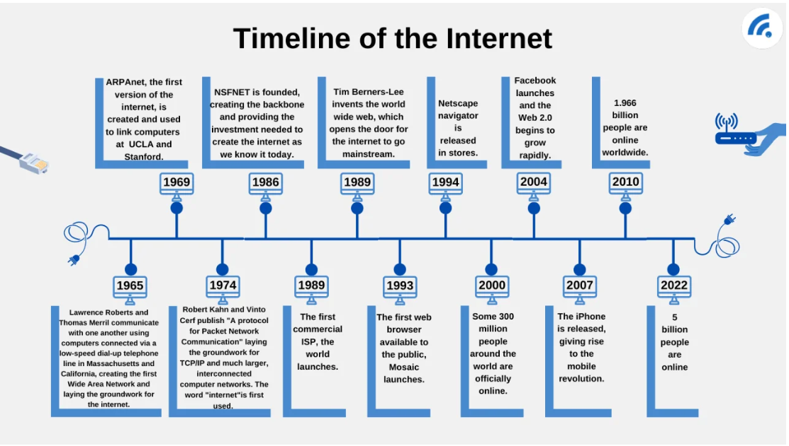

Slide 27
BASIC NETWORK UTILITIES
Ipconfig: shows your system’s IP address, Subnet mask and Default gateway
Ping: Ping tells if a system is connected to the network.
Tracert: Shows every “hop” between host and destination address
Netstat: Network status Shows active connection

Slide 28
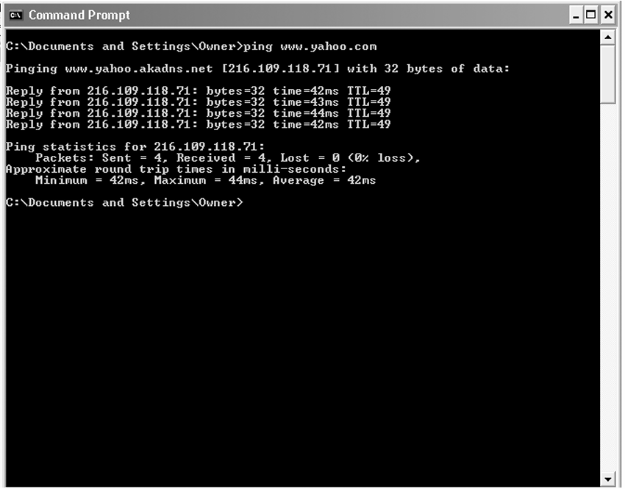

Slide 29
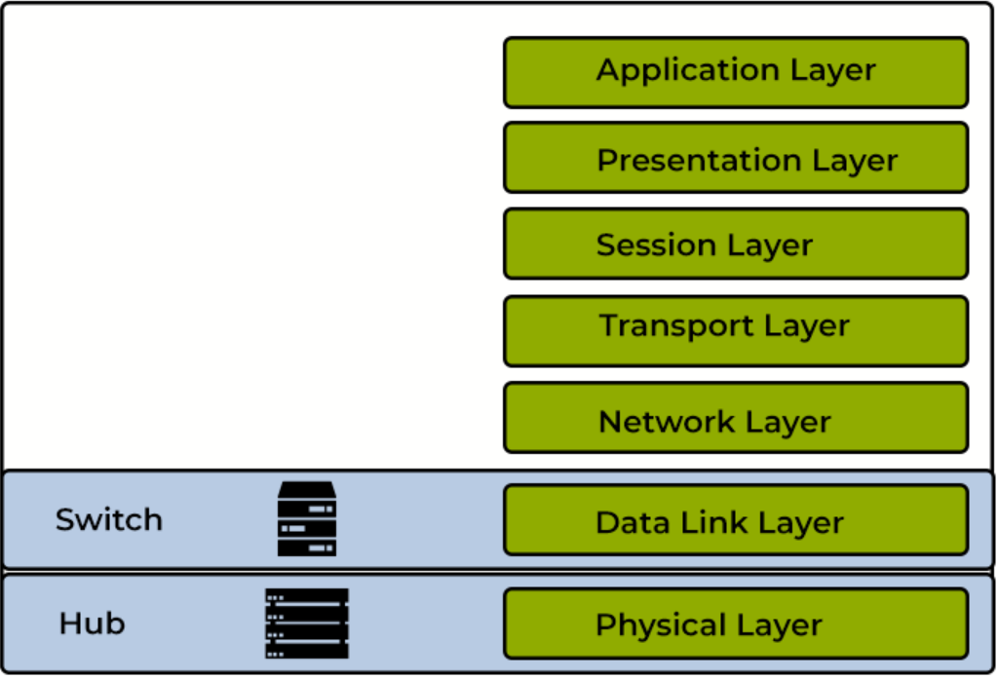
OSI MODEL

Slide 30
Thank you!
“Knowledge is the best program ever written”

